Slide 1
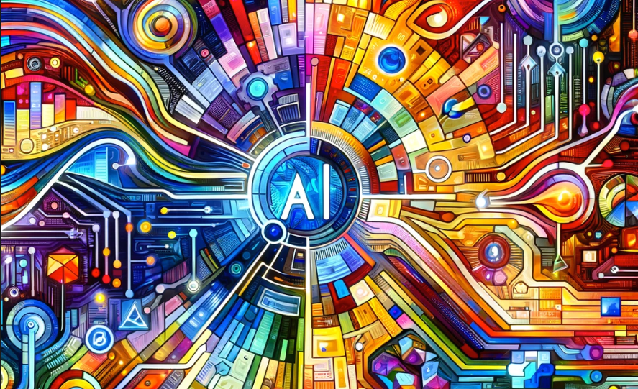
GenAI Accelerates Analytics Maturity
Getting to Stage Five Faster
Dan McCreary
December 2023

Slide 2
Talk Description
Title: How Generative AI is Accelerating Analytics Maturity
In this talk, we delve into the transformative impact of Generative AI on analytics maturity. We explore how GenAI is impacting the field of data analytics. GenAI generates code, reduces development times, and suggests complex data analysis. GenAI creates synthetic test data, a vital aspect in today's data-driven world, where data quality and privacy are paramount. We show how GenAI enhances data analysis itself, offering advanced insights and predictive analytics by processing large datasets with unprecedented speed and accuracy. Throughout the presentation, we underscore the significant leap in a five-stage analytics maturity model enabled by these AI-driven advancements, illustrating a future where data analytics is more efficient, secure, and insightful than ever before.

Slide 3


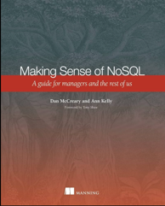


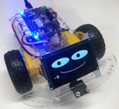



Background for Dan McCreary
Solution architect with over 35 years working with data
Worked for Bell Labs and Steve Jobs at NeXT
Author of a book on database selection, “Making Sense of NoSQL”
Promoter of graph query standards (ISO GQL)
Former Distinguished Engineer working for Optum (UHG)
Built the world’s largest healthcare knowledge graph
Led the “Generative AI Center of Excellence” at Optum
Worked with over 250 generative AI uses cases – 50 of which were funded and over 10 in production
Blogger: http://medium.com/@dmccreary
Big fan of AI, robotics, MicroPython, and AI in STEM education, MicroSims
Advocate for neurodiversity

Slide 4
Capability Maturity Model
Go Faster!!
Level 5
Optimized
Level 4
Measured
Level 3
Defined
Everyone in
the organization
Level 2
Manged
Products
integrated
Level 1
Initial
Many teams
managers
A team and a few
managers
A few people
Five level maturity model
From single person “Heroic Effort” to organization-wide awareness

Slide 5
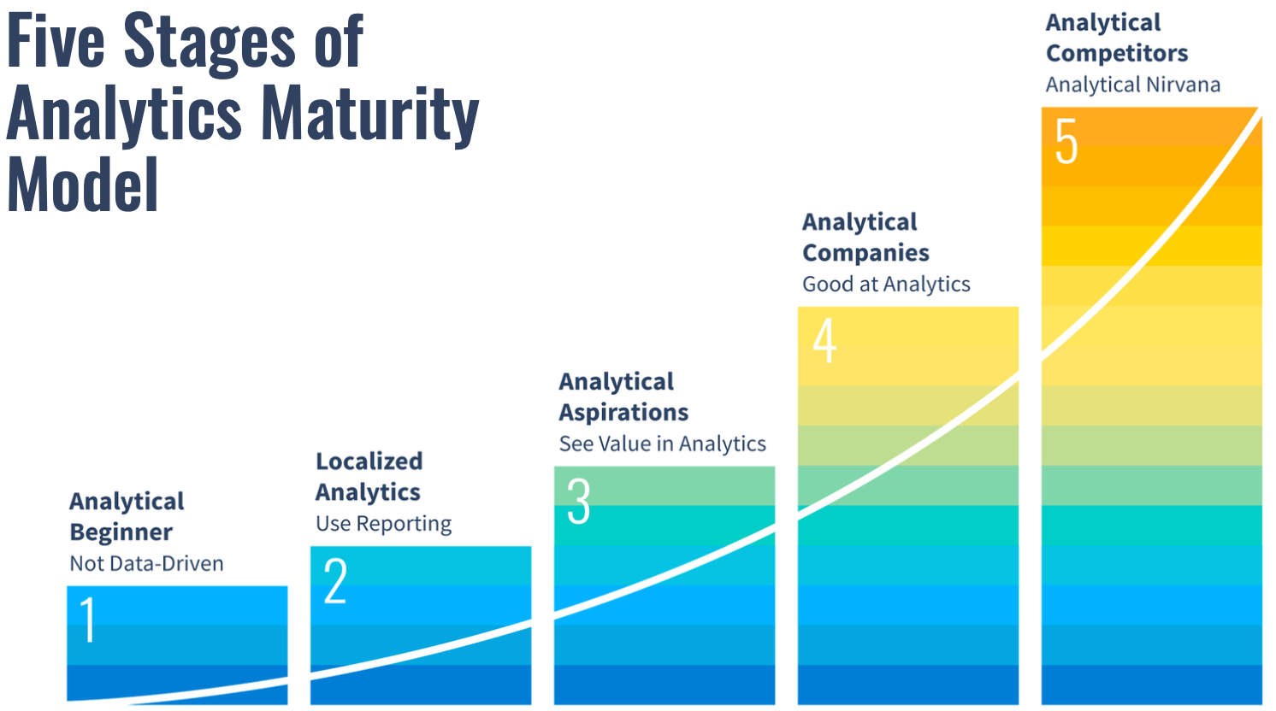
IIA Five Stage Model
IIA = International Institute of Analytics
80% of MN
Organizations
are Here
Notes:
https://iianalytics.com/resources/delta-plus-model-and-five-stages-of-analytics-maturity-a-primer

Slide 6
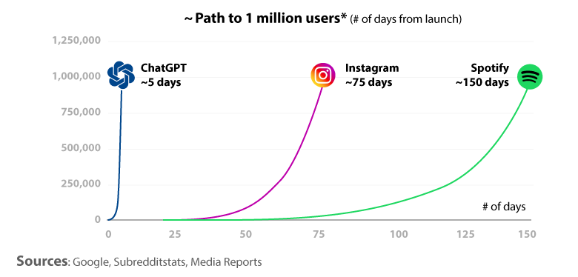
The Rise of Large Language Models
In 2022 we saw the incredible rise of ChatGPT and the growth of large language models
ChatGPT reached over 1 million users in just five days and over 100M users in just a few weeks
But will these large language models (LLMs) alone help us serve our customers?

Slide 7
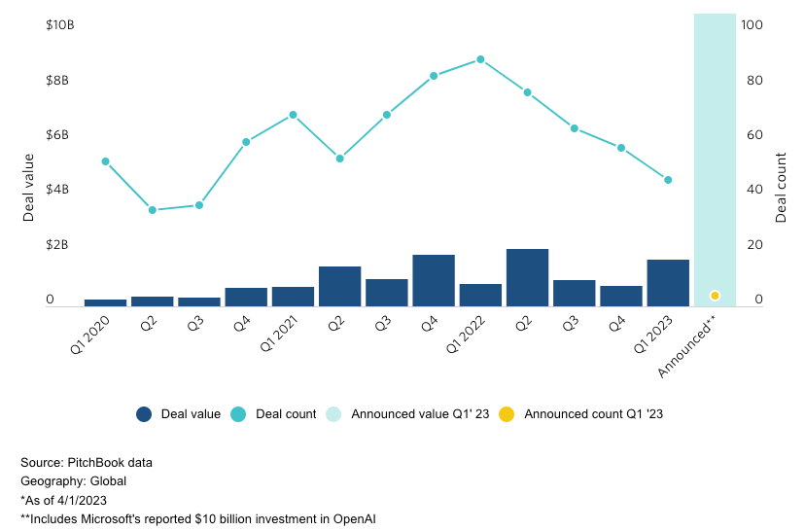
Skyrocketing Growth of Generative AI Investments

Slide 8
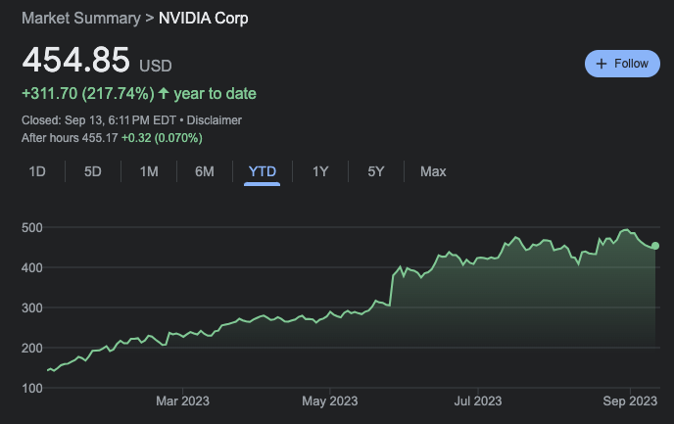
NVIDIA Stock TYD: up 217% in 2023
Today: 465
NVIDIA is the top performing
Stock in 2023
NVIDIA H-100
Manufacturing Cost: $2,500
Price: $32,000

Slide 9

Generative AI is Getting Massive New Funding
$40 Billion
In 2023
Over $40 billion dollars was invested in generative AI in 2023
Microsoft alone has invested over $12B in OpenAI
Pitchbook has tracked over $12B in new generative AI funds in 2023
Billions invested in new AI hardware products (FPGA, custom chips)
Many generative AI venture funds are focusing on specialized tasks in specific industries (healthcare)
Vision: Every knowledge worker has 10,000 intelligent agents willing to help

Slide 10
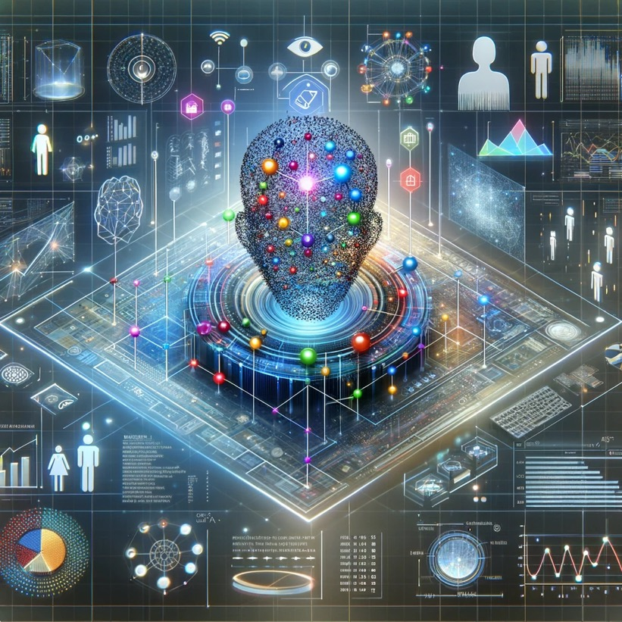
Organization Data Is Everywhere
Paper and online forms
Customer feedback
Call center logs
Call center transcripts
Customer visits to website
Customer searches
Customer surveys
Customer returns
Social media comments

Slide 11
Analytics References Architecture
Message Queues
Analytics
Data Warehouse
Operational
Source
System
Change
Data
Capture
Dashboard
Operational
Source
System
Change
Data
Capture
Analytics Data Warehouse
Operational
Source
System
Change
Data
Capture
Reports
focus on counting items
How do we get more data into our Analytics Data Warehouse faster?
How do we get better reports out of the system faster?
How is comparison related to traditional counting?
What about intelligent agents?

Slide 12
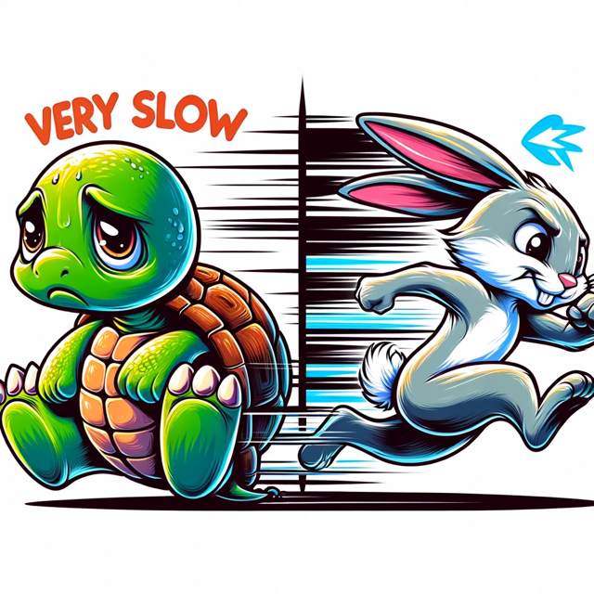
Summary of Tasks
Free-form text to machine-readable data
Stories, Acceptance Test Plans
Generate code
Generate test cases and synthetic data
Generate sample models
Populate models
Generate analytics queries
Generate dashboards
Generate reports
Super Fast!
Common theme: All the tools and processes used to build better analytics workflows will be impacted.

Slide 13
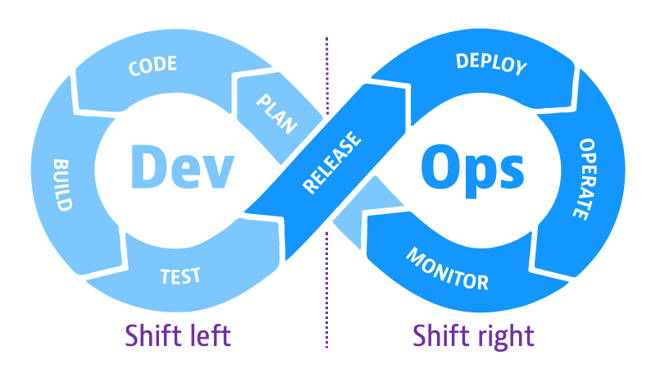
Include “Shift Left” Tasks
Left: everything we do before we release code – what we are build
Right: everything we do after we deploy code – how we are deploying
Generative AI allows fewer developers to do more tasks keeping teams smaller
Smaller teams mean less communication overhead and fewer meetings

Slide 14
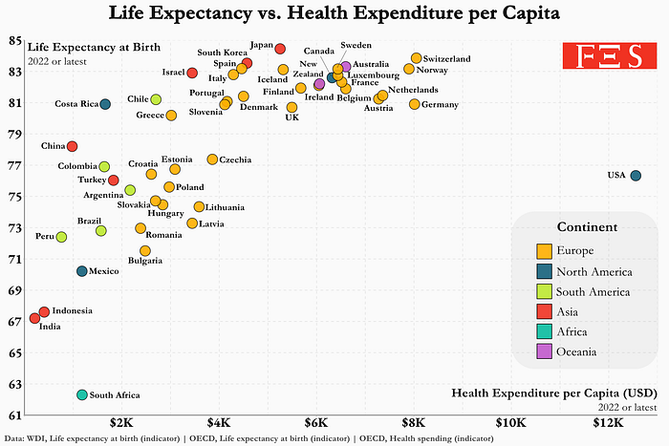
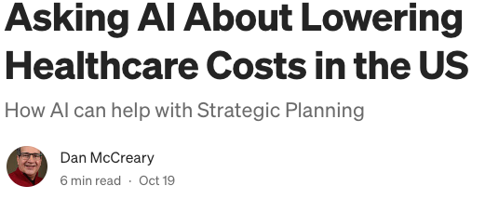
Open AI ChatGPT Advanced Data Analytics
Steps
Upload CSV Data
Ask for insights
Why is healthcare so expensive in the US?
Upload CSV files life expectancy and healthcare costs by country
Ask it to analyze data, find root causes and suggest solutions
https://dmccreary.medium.com/asking-ai-about-lowering-healthcare-costs-in-the-us-7224b4f958cc

Slide 15
From Analysis to Strategy
Other
Why is Healthcare Expensive in the US?
Root Cause
Analysis
Search for
Solutions
Other
Focus on
Value
Based
Care
How Knowledge
Graphs Can Help
Data
Challenges
Challenges with Implementing VBC
Generative AI is more than just generating code!

Slide 16
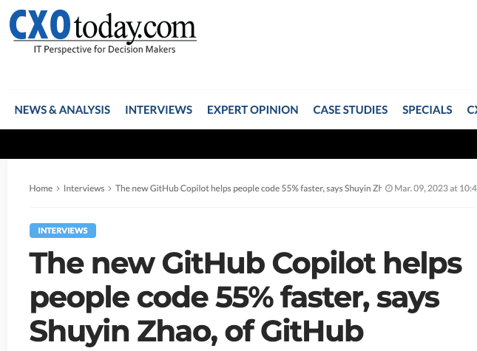
Microsoft GitHub Claims
55% improvement in productivity in coding
The average software developer spends under two hours a day writing code

Slide 17
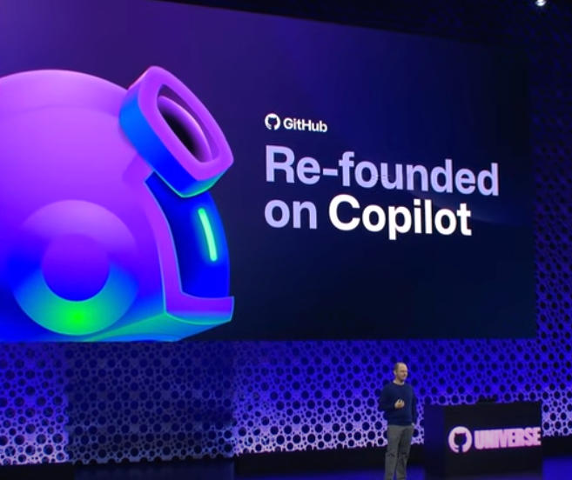
GitHub “Re-Founded” Copilot
https://www.youtube.com/watch?v=NrQkdDVupQE

Slide 18
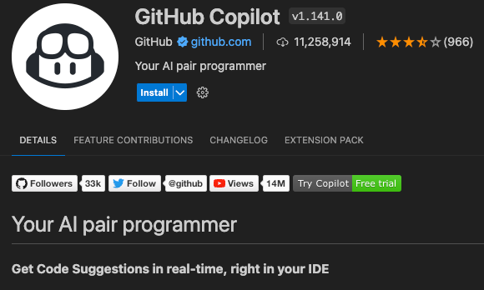

GitHub Copilot
VS Code -> Settings -> Extensions -> Search for “Copilot”
Over 11M users
Free Trial, $10/month, or $100/year

Slide 19
Generate Synthetic Test Data
ChatGPT Prompt:
Create a sample dialog about a person that is trying to get her home address authenticated and a call center. She filled out the on-line forms but has not got approval for a month. She is frustrated.

Slide 20
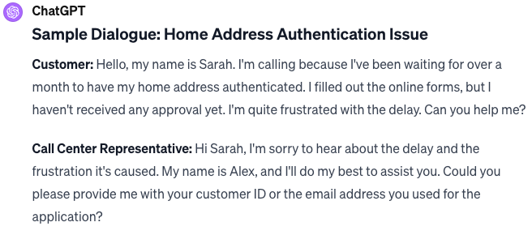
ChatGPT Sample Dialog Output

Slide 21
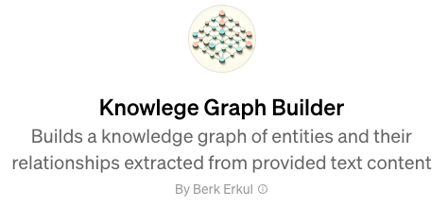
Knowledge Graph Builder
OpenAI GPT
Converts any text into a knowledge graph
https://chat.openai.com/g/g-5iaafjkKY-knowlege-graph-builder/c/154426f2-3ec0-4193-8845-09bb9533653f

Slide 22
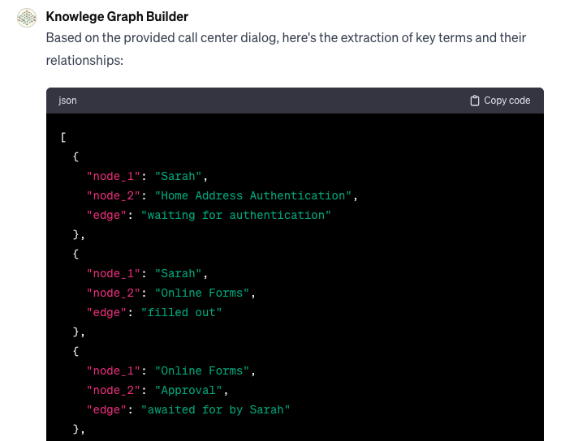
Finding the “Nouns” and “Edges”
Text to JSON file

Slide 23
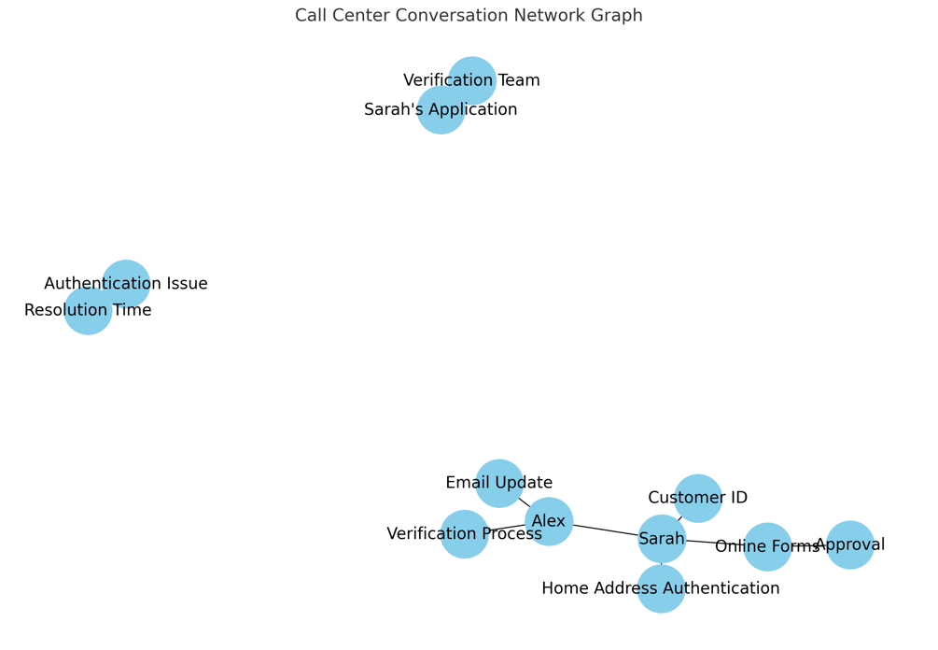
Graph Representation
How can we connect this graph to a central data warehouse?
Analytics is just counting the number of links!

Slide 24
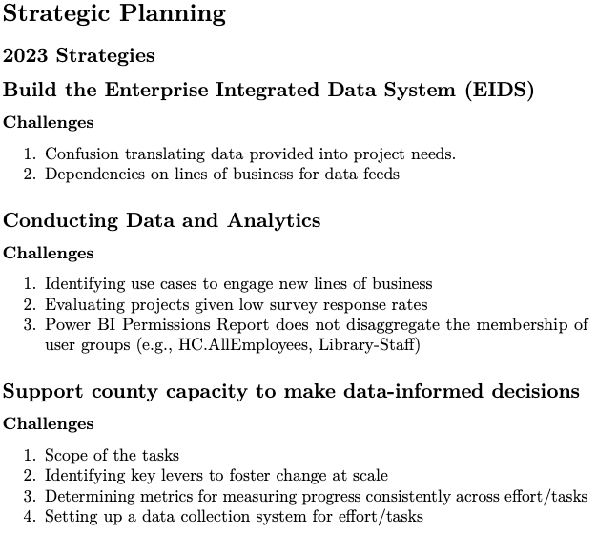
Strategic Planning Document

Slide 25
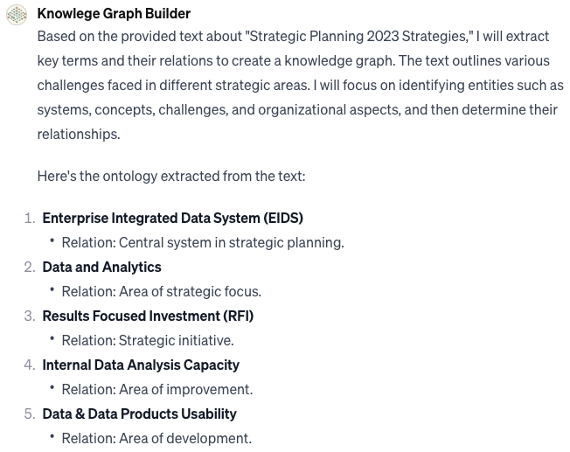
Strategy Text to Ontology
24 key “vertices” (nodes) identified
Key relationships found

Slide 26
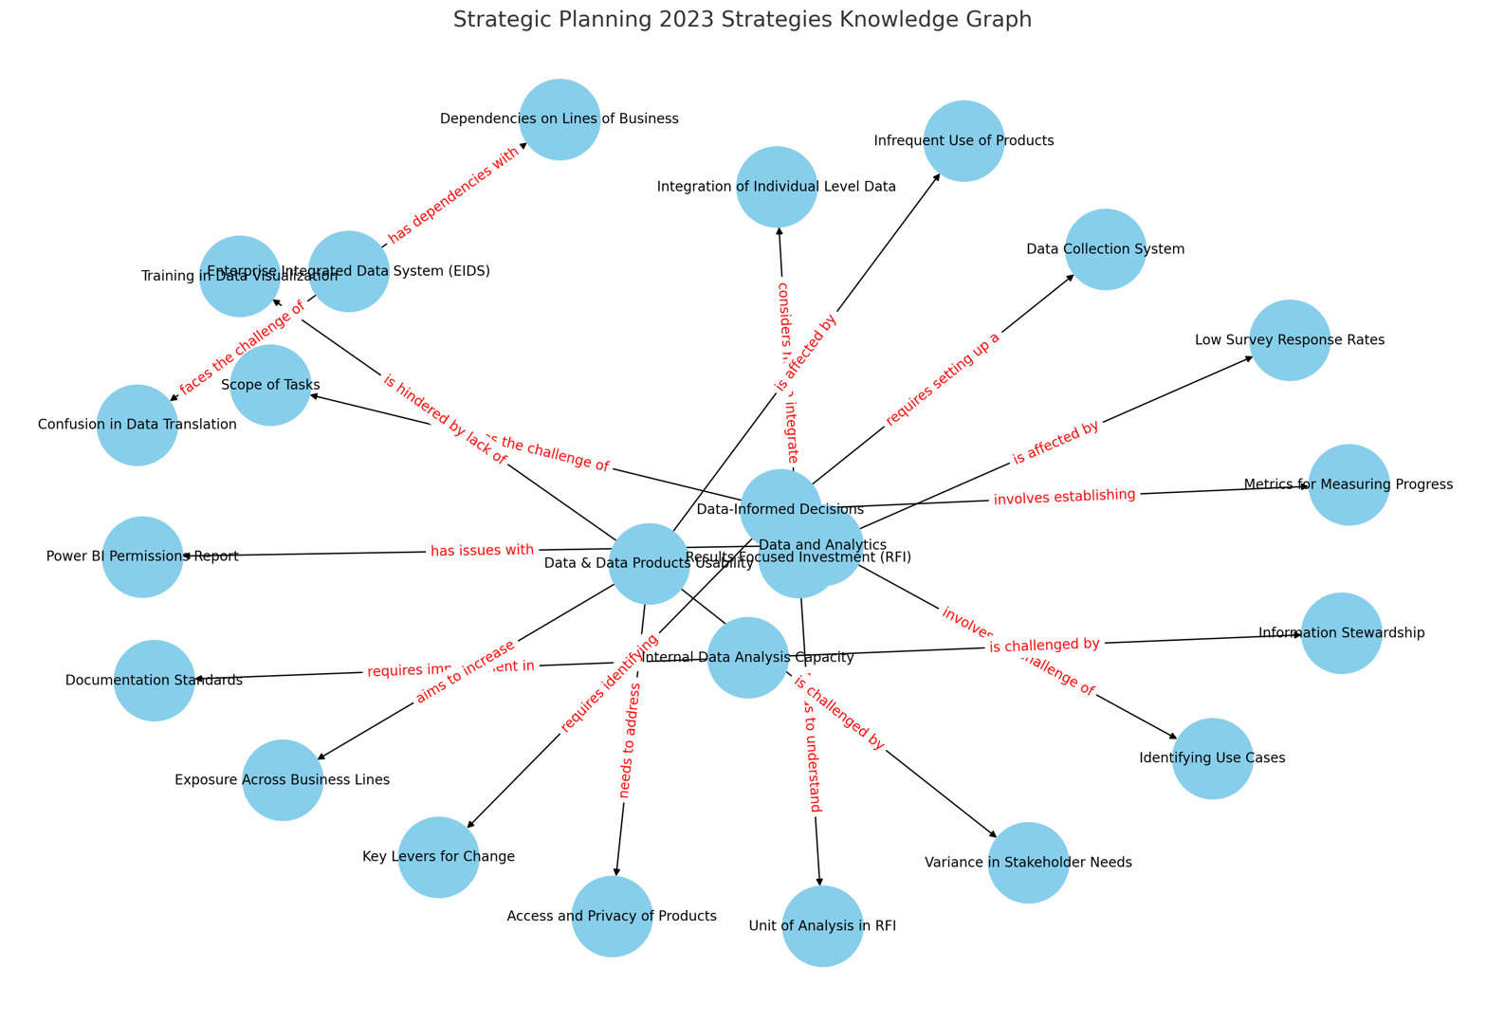

Slide 27
Six Ways to Store Knowledge
Relational
Analytical (OLAP)
Key-Value
key
value
key
value
key
value
key
value
Column-Family
Graph
Document

Slide 28
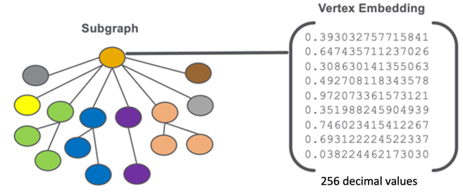
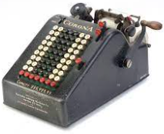

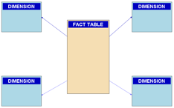
From Counting to Comparison
Counts and Amounts
Comparison and Similarity
Focus on adding up numbers in columns of tables
RDBMS, Fact tables, aggregate design
Focus on quickly finding the similar items
Similar concepts in a question to a chatbot
Similar images, words, text, ideas
This is a central concept when explaining generative AI to stakeholders.

Slide 29

What is the Role of a Knowledge Graph?
What would a “model” of our organization look like?
Would it include:
Our customers?
Our products?
Our competition?
Our personal notes?
What tools do we have to model the real world?
Excel?
CSV Files?
RDBMS?
A knowledge graph?

Slide 30

Centralized Knowledge
Centralized
Knowledge Graph
Intelligent Agents
Text
CSV Files
Log Files
Images
Sound
Video
Personal Knowledge Graphs
Knowledge Workers
Intelligent Agents Need Connected Knowledge to Help Knowledge Workers
Disconnected spreadsheets will not help intelligent agents

Slide 31
Innovation Zone
ChatGPT
The
Innovation
Zone
Large
Language
Models
Knowledge
Graphs
Models of the real world
A model of langauge

Slide 32
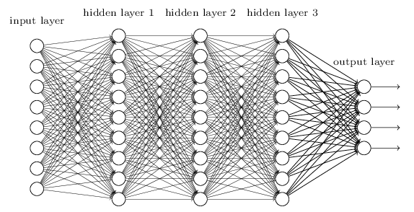
Deep Neural Networks
Deep Neural Networks are part of the solution, but they are not at the center of the intelligent organization
DNNs lack explainability and are subject to errors (hallucinations)

Slide 33
Challenges with Deep Neural Networks
Knowledge is dispersed over the entire network
Probabilistic reasoning: no guarantees of correctness
Extremely low explainability (why did you make that recommendation)
It can be very expensive to train LLMs ($100M)
No way to remove an incorrect fact

Slide 34

Analyst Workflows Today
Get requirements
Source the data
Understand the data
Clean the data
Remove the duplicate from the data
Join the data
Create a model
Run the model
Present a report with insights
Delete everything

Slide 35
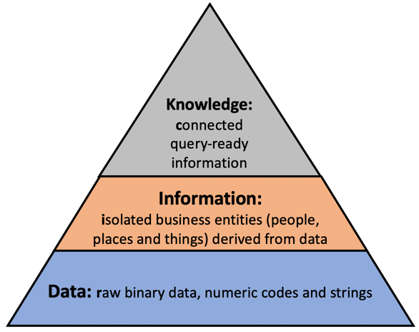
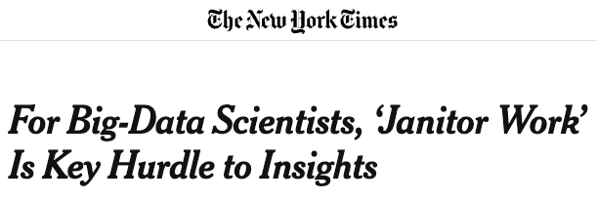
Challenges of Data Engineer-Focused Approach
80% of effort is low-level data engineering “Data Janitor Work”
Very little focus on building reusable assets
Every project is a “one-off” project
No consideration given to future reuse of knowledge
Difficult to estimate time and costs

Slide 36
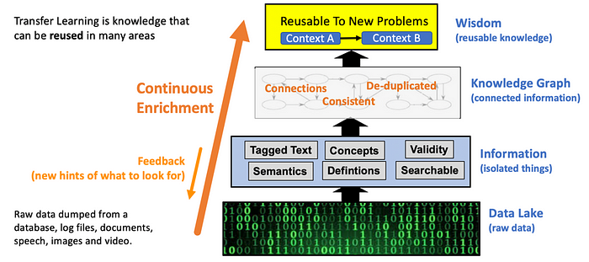
Knowledge Engineering

Slide 37

Challenges of Adopting a Knowledge Graph
Information is siloed in many databases and proprietary applications
Individual analysts access the data, do some analysis, create a presentation, and throw the knowledge away
Low reproducibility and no incentives to make the knowledge more accessible to future analysts

Slide 38
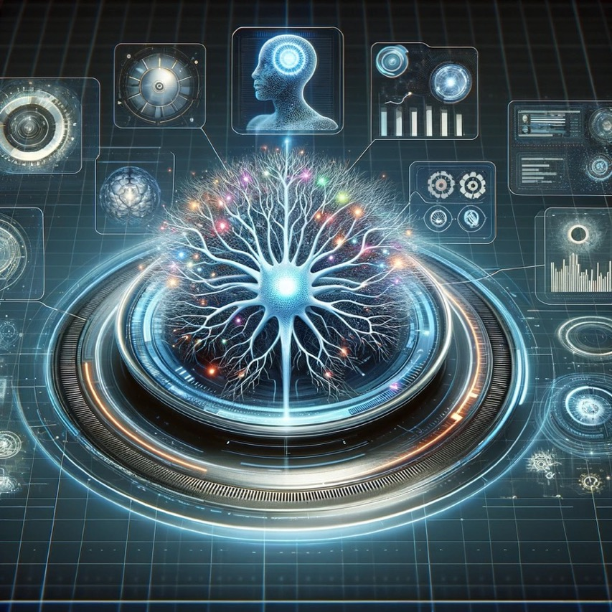
The Graph Is the Organization
A central knowledge graph will become foundation that AI agents run on
Agents continually gather new knowledge and store in ways that future agents can benefit – reuse!
Both knowledge and algorithms will be embedded in the centralized knowledge graph

Slide 39
Accelerating Movement from 2 to 3

Slide 40
Summary
Large language models are not sufficient for us to model the world
Knowledge graphs are not sufficient to bring in complex data and allow users to ask English language questions of systems
By combining large language models with knowledge graphs, we can build intelligent systems that have a holistic view of our organizations
Knowledge
Graphs
Innovation
Zone
LLMs

Slide 41

The role of story telling in analytics
Our brains have evolved to remember stories
Managers have a difficult time remembering facts
We need to translate our analytics success stories into stories that can be retold

Slide 42
Call to Action!!
We need:
Visionary thought leadership
Drawing clear pictures of the future and maps with paths to get us there
Tell stories that our leaders can remember
You don’t need to be a manger to be a thought leader!
Empathy for our members, agents, partners, vendors and customers
If we can’t model it, we can’t understand it
Willingness to let go of simple models that don’t serve our customers
Knowledge transfer to our future engineers
Prompt engineering for everyone in a safe place
Knowledge graphs
Generative AI

Slide 43

Thank You!
Thanks to Erik Erickson and Bryan Félix for hosting me!
Questions
https://www.linkedin.com/in/danmccreary

